Slide 1
FYP Proposal Defense Degree Verification system using blockchain
GROUP MEMBERS
S.No. | Enrollment # | Student Name
1 | O2-131192-057 | Sumayya Khalid
2 | 02-131192-081 | Rabya Essani
3 | 02-131192-082 | Adil Waheed

Slide 2
Table of Contents
Introduction
Background
Problem Statement
Proposed Solution
Project Scope
Work Breakdown Structure / Gantt Chart
References

Slide 3
Introduction
- Educational Degree Verification System:
Traditional Educational degree verification is very time consuming process, chances of certificates alteration/fraud.
We choose Blockchain technology because it is traceable, tamper-proof, and encrypted.
Dynamic QR-code and unique certificate generate for each students in proposed system.

Slide 4
Background
Already available solutions
This idea has been proposed in many Research papers and also has been implemented in institutes such as the University of Birmingham.
Their project consist of verification of certificates .
We are planning to implement with the feature of verification of transcripts and degrees. So, if any student request for transcript while their schooling period due to any particular reason they can get a verified E-transcript through email.
Reference.
https://intranet.birmingham.ac.uk/it/innovation/documents/public/Experiments/Blockchain-based-Academic-Certificate-Authentication-System-Overview.pdf

Slide 5
Problem Statement
In the current scenario, the Degree/Transcript is stored in a centralized manner, so it takes too much time to verify them.
Degree/Transcript can be easily hacked and duplicates of that certificates can be made.
Students also facing the problem of losing the certificate.
When students bring their certificate to the interview, there is no security for degree/transcript and the certificates or mark sheets might be modified.

Slide 6
Proposed Solution
Features of the project
Privacy: The marks of the student will not be disclosed.
Accuracy: The marks/Grade will be stored accurately within the system
Robustness: Nobody will be able to modify the transcript detail but only be able to verify it
Methodology/Algorithm
The student’s degree/transcript and details will be uploaded by the Institute.
Using these details a pdf of the degree/transcript is Generated
The pdf is hashed
The hash value generated in the above step is stored on the blockchain after hashing it with the private key
The degree/transcript is mailed to the student.

Slide 7
Cont…
Technologies to be used
EVM, Solidity, React.Js, Node.Js, Ganache CLI
Sustainable Development Goals Mappings
Quality Education
Create Decent Work and Economic Growth
Guarantee Peace, Justice, and Strong Institutions.
Reference: https://sdgs.un.org/goals

Slide 8
Project Scope
Main Areas:
Login for Institute
Generate E- degree/transcript with a QR code.
Degree mailed to students
Public Verification
Maintenance of Academic Records on blockchain.
Goal:
Our System automates the process of generating degree/transcript and reduces the manual work needed for the verification of the same.
Students are also at comparatively low risk of losing the degree/transcript .
By using an additional hashing algorithm we are decreasing the percentage of data being tampered with.

Slide 9
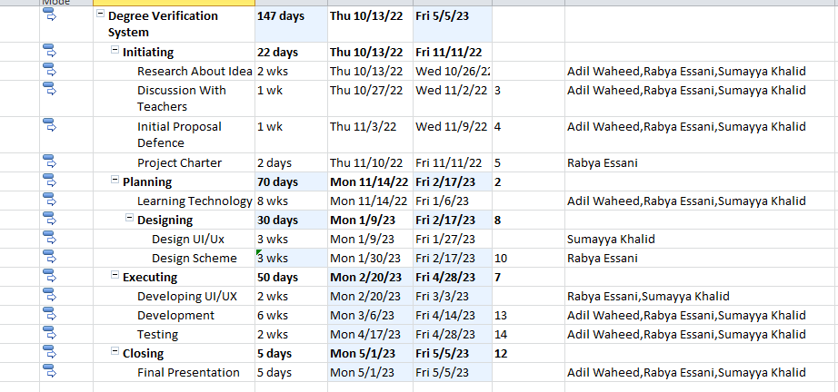
Gantt Chart

Slide 10
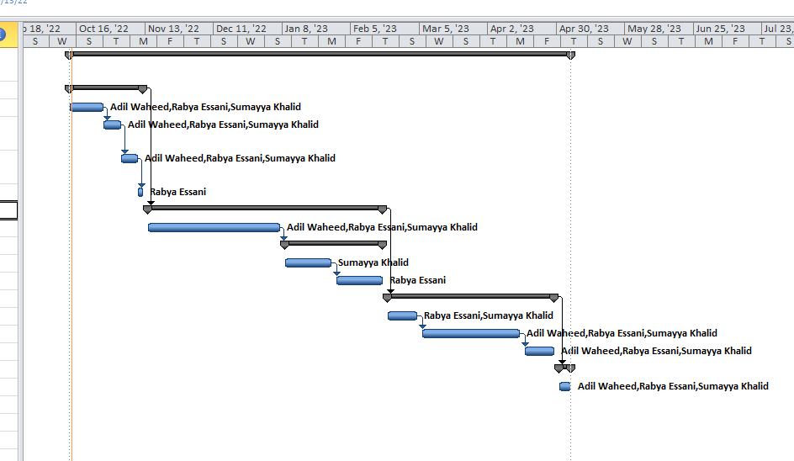
GANTT CHART

Slide 11
References
References:
[1] -Department of Computer Science and Engineering, Thiruvallur,TamilNadu Online Certificate Validation Using Blockchain, https://www.ijana.in/papers/37.pdf .
[2] - Rohan Hargude, Ghule Ashutosh , Computer Department, Pune, India
https://ijcrt.org/papers/IJCRT2107013.pdf,7 July 2021.
[3]- International Journal of Engineering Research & Technology (IJERT) , Ravi Singh Lamkoti Dept. of Information Technology Vidyavardhini's College of Engineering and Technology Vasai, Palgha , https://www.ijert.org/research/certificate-verification-using-blockchain-and-generation-of-transcript-IJERTV10IS030260.pdf ,3 March 2021.
[4]- Jayesh G. Dongre Smt. Indira Gandhi College of Engineering Navi Mumbai, India, Education Degree Fraud Detection and Student Certificate Verification using Blockchain,https://pdfs.semanticscholar.org/e086/5f8e32239882ace2123ae39706cd39b2f2aa.pdf ,7 July 2020.
rabyaessani@gmail.com

